Slide 1



SECUREBOOKS INC.
ENTERPRISE NETWORK DESIGN
SECURE MULTI SITE INFRASTRUCTURE IMPLEMENTATION
Group members:
Syed Ahtsham (242364), Ahmed Saleem (242348), Muhammad Haseeb (242292)
Instructor: Ms. Maila Zahra

Slide 2









OVERVIEW
SECURE CONNECTIVITY
ADVANCED ROUTING
ACCESS CONTROL
Designed a secure enterprise network connecting Headquarters (HQ) and Remote Branch operations using industry best practices.
Implemented VLSM for efficient IP usage and a Hybrid Routing strategy combining RIPv2 for LANs and Static Routing for secure segments.
Enforced the Principle of Least Privilege using Extended Access Control Lists (ACLs) to strictly filter traffic flow.

Slide 3




PROBLEM STATEMENT
IP CONSTRAINT
NETWORK CONSTRAINTS
Restricted to a Single Class C block (172.16.10.0/24).
The current infrastructure faces significant limitations that hinder scalability and security.
EFFICIENCY
Zero IP wastage requirement necessitating precise subnetting.
"To design a robust network within a restricted IP address space while ensuring maximum security for sensitive zones."
SECURITY
Secure DMZ deployment with strict traffic filtering policies.

Slide 4

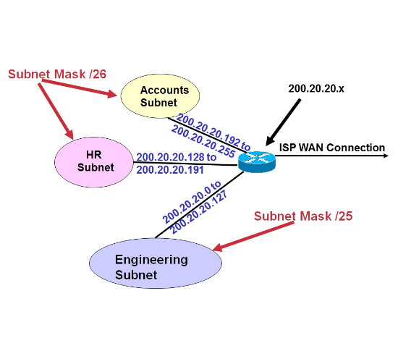
PROPOSED SOLUTION
VLSM based Segmentation:
Utilizing Variable Length Subnet Masking to allocate IP addresses based on exact host requirements, ensuring zero wastage.
Hybrid Routing Protocol:
Deploying RIPv2 for dynamic LAN updates and Static Routing for secure, predictable paths to the DMZ.
Extended ACLs:
Implementing rigorous packet filtering rules to explicitly block Branch access to the Database server while allowing Web traffic.

Slide 5









LITERATURE REVIEW SUMMARY
VLSM
RIPV2
DMZ CONCEPT
Variable Length Subnet Masking is the industry standard for IP optimization, allowing different subnet masks within the same network address space.
Routing Information Protocol version 2 is selected for small to medium networks due to its simplicity, support for VLSM, and multicast updates.
A Demilitarized Zone acts as a security buffer, exposing external facing services (Web) while keeping internal assets (DB) strictly isolated.

Slide 6
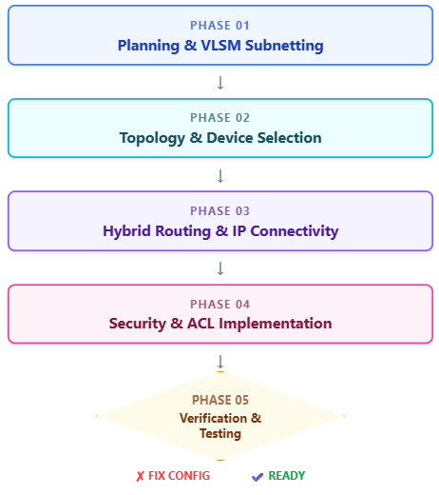
METHODOLOGY
IP Planning: Efficient subnetting using VLSM.
Topology: Designed and simulated in Packet Tracer.
Routing: Hybrid RIPv2 and Static Routing setup.
Services: Automatic IP allocation via DHCP pools.
Security: Access control via Standard & Extended ACLs.
Testing: End-to-end connectivity and policy validation.

Slide 7
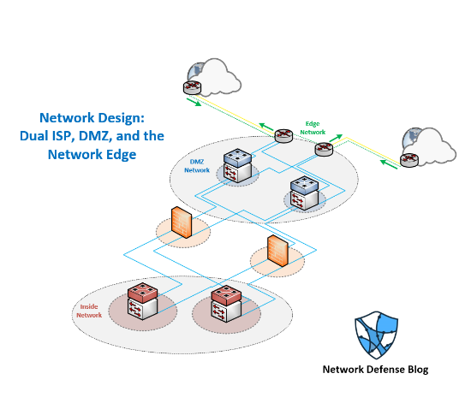
SYSTEM ARCHITECTURE
ARCHITECTURAL FLOW
User Layer: Authenticated users at HQ and Branch.
Core Routing: HQ Router acts as the gateway, managing traffic between local LANs and remote sites.
Secure Layer: ACLs inspect every packet at the network edge.
DMZ Isolation:
Web Server: Accessible to all.
Database Server: Restricted to HQ only.

Slide 8

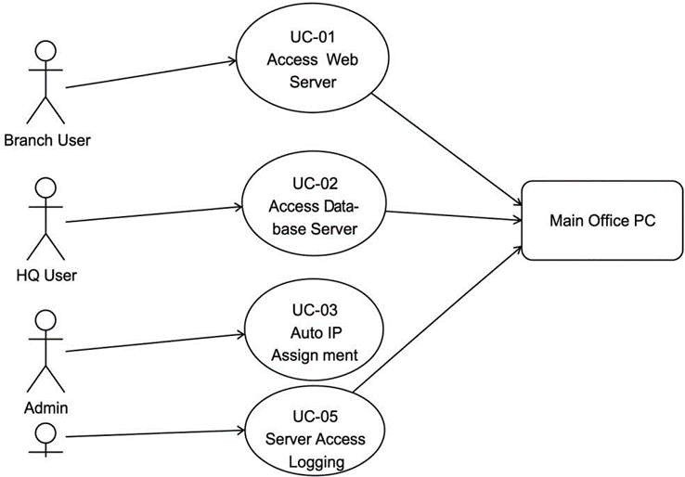



USE CASE DIAGRAM
ACTOR PERMISSIONS
BRANCH USER
HQ USER
NETWORK ADMIN
Routing Config, ACL Management, Logging & Monitoring.

Slide 9




KEY TEST CASES
Case ID | Source | Destination | Result / Status
TC-01 | Branch PC | Web Server
TC-02 | Branch PC | Database Server
TC-03 | HQ PC | Database Server
TC-04 | HQ PC | Web Server
TC-05 | HQ PC | DHCP Request

Slide 10








MARKET VALUE & IMPACT
TARGET AUDIENCE
SKILL DEMONSTRATION
COMPETITIVE EDGE
Ideal solution for SMEs (Small to Medium Enterprises), academic laboratories, and technical training centers requiring secure, low cost simulation.
Validates high level competency in enterprise security, switching, and routing key skills for modern Network Engineers.
Comparable to configurations found in Cisco Meraki or Fortigate deployments, offering a strong foundational model for commercial use.

Slide 11
PROJECT TIMELINE (GANTT CHART)
Project Phase | Weeks 1–2 | Weeks 3–4 | Weeks 5–6 | Weeks 7–8
Research & VLSM
Configuration & Routing
ACL Security Policies
Testing & Final Report
Horizontal bars indicate active phase duration.

Slide 12

CONCLUSION
PROJECT ACHIEVEMENTS
Zero IP Wastage: Successfully achieved through precise VLSM calculation and implementation.
Robust Security: The Database is fully protected from unauthorized Branch access, verified by ACL testing.
Enterprise-Ready: The design is secure, scalable, and follows modular architecture principles suitable for real-world deployment.

Slide 13


REFERENCES
Baker, F. (1995). RFC 1812: Requirements for IP Version 4 Routers. IETF.
Tanenbaum, A. S. - Computer Networks (5th Edition). Pearson Education.
Kurose, J. F., & Ross, K. W. - Computer Networking: A Top-Down Approach. Pearson.
Cisco Systems - Cisco IOS IP Routing: RIP Configuration Guide.

